Slide 1
Final Project Report
“Wireless embedded system for human activities recognition using ESP32 and Jetson Nano”
Group 03 – NT131.O12.MMCL
Instructor: Assoc Prof. Lê Trung Quân

Slide 2
Members of group 03
Tống Võ Anh Thuận
Trần Công Hải
21522652
21520811

Slide 3
Table of content
01
Project overview
02
System architecture
03
System realization
04
System demonstration

Slide 4
01
Project overview
Introduction of the topic and related definitions

Slide 5

In this project, we:
- Capture CSI signal data from Wi-Fi communication between embedded devices.
- Train a deep learning model to recognize human activities based on the CSI data.
- Publish prediction to an MQTT server for monitoring.

Slide 6
About CSI signal
Channel State Information is a signal metric captured in communication systems
It allows data-symbols to be encoded in multiple subcarrier frequency
The CSI value for each subcarrier is defined as a complex number with a real component and an imaginary component

Slide 7
About deep learning model
CSI data is complex => Use CNN model for this task
A Convolutional Neural Network (CNN) is a type of neural network that is well-known for tasks like image classification.
After researching, we find that it can be used to learn CSI signal data as well

Slide 8
About MQTT protocol
MQ Telemetry Transport, is a lightweight messaging protocol designed for resource-constrained devices and low-bandwidth environments.
Operate in a pub-sub model.
=> Well-suited for the Internet of Things (IoT) communication

Slide 9
02
System architecture
Key components of the system

Slide 10
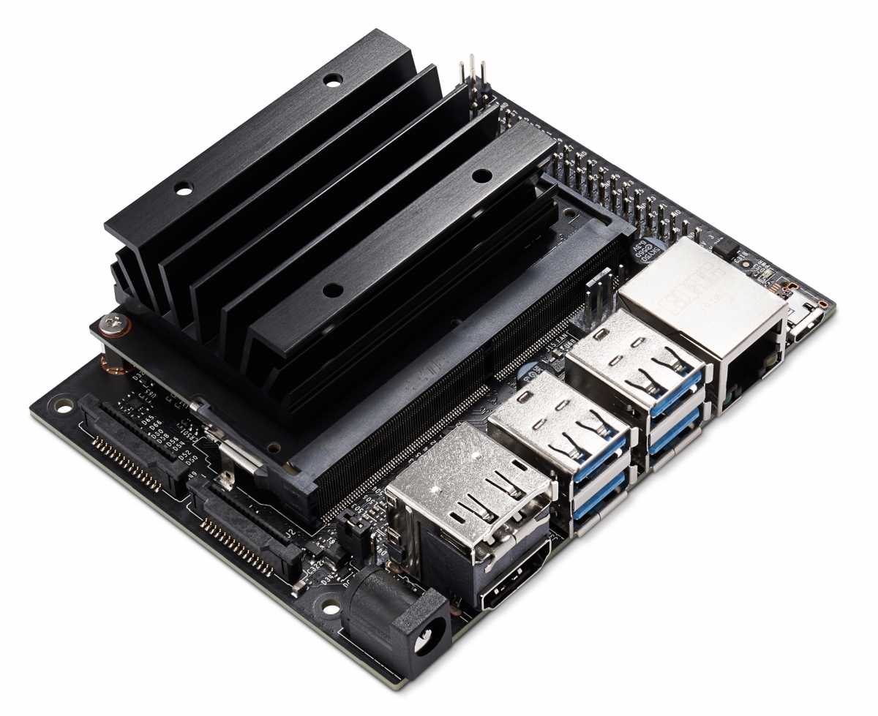
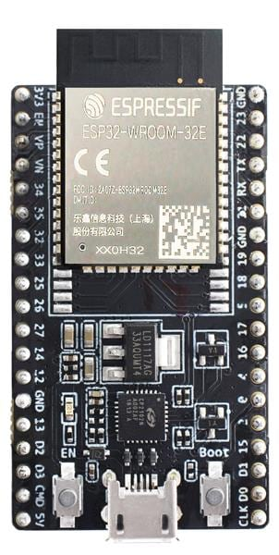
System architecture
ESP32 Microcontroller
Jetson Nano
Transmit CSI data via Wi-Fi
TX
RX
Send CSI data via serial port

Slide 11




System architecture
MQTT Client
MQTT Broker
Subscribe and receive prediction
Publish prediction
<- 3 meters apart ->
Sampling rate: 100Hz ~ 100 pkt/s
(Process data and make prediction with CNN model)
TX
*Performs activity*
RX
Baud rate: 921600

Slide 12
03
System realization
Configuration steps and training the model

Slide 13

Configuration
+
ESP32 CSI Toolkit
Station mode
AP mode
ESP32 CSI Toolkit (stevenmhernandez.github.io)

Slide 14
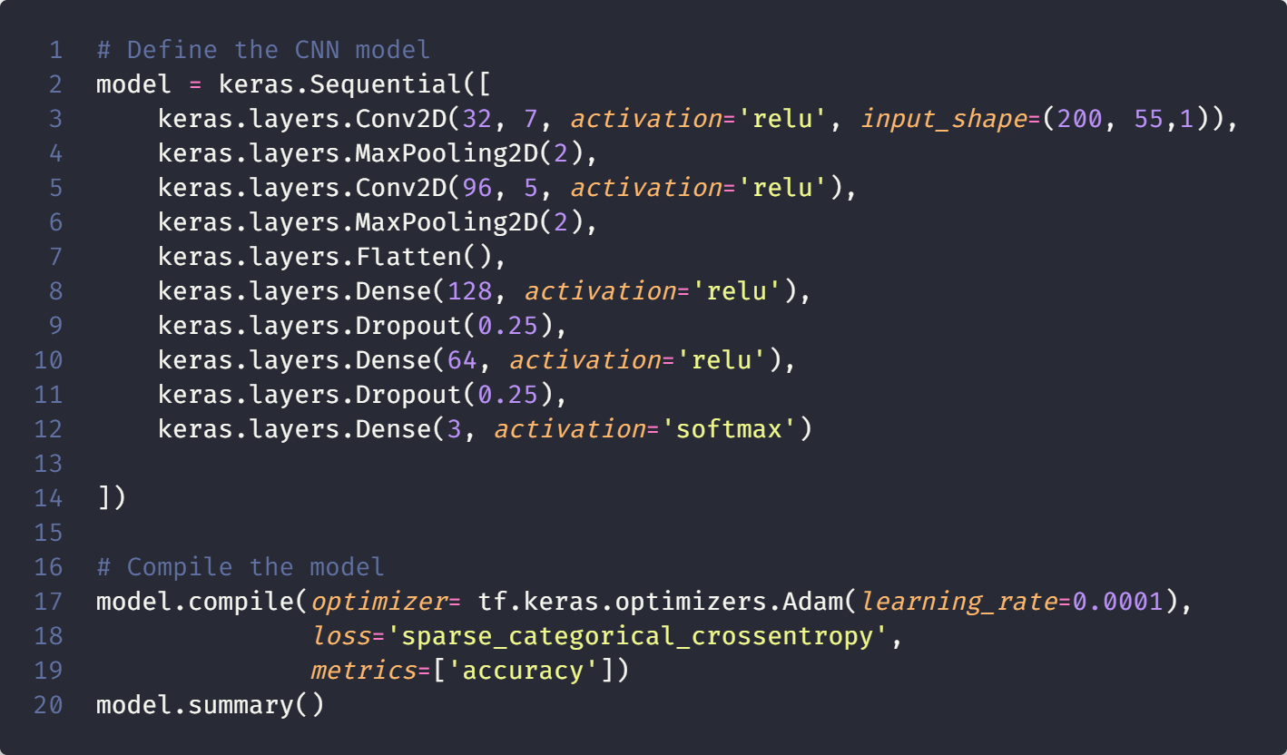
Training model
Data collection
Segmentation
Extract amplitude
Null filter
---->

Slide 15
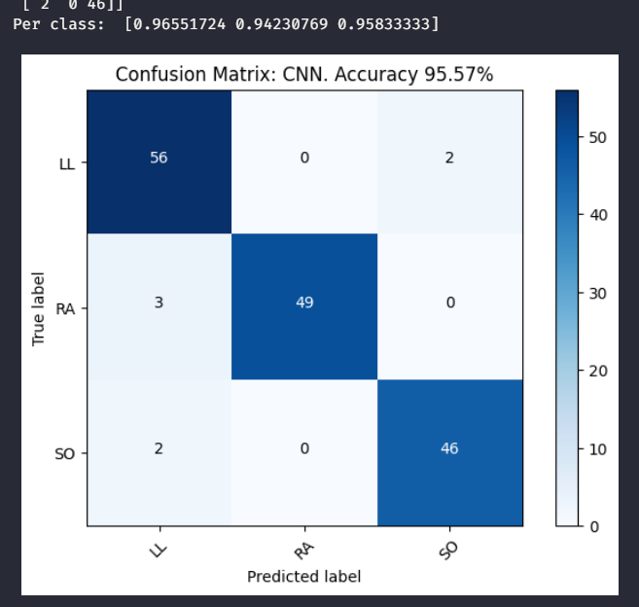
Training model
Dataset: 525 segments of 200 packets = 105,000 packets
Validation loss: 0.2469
Validation accuracy: 0.9324

Slide 16
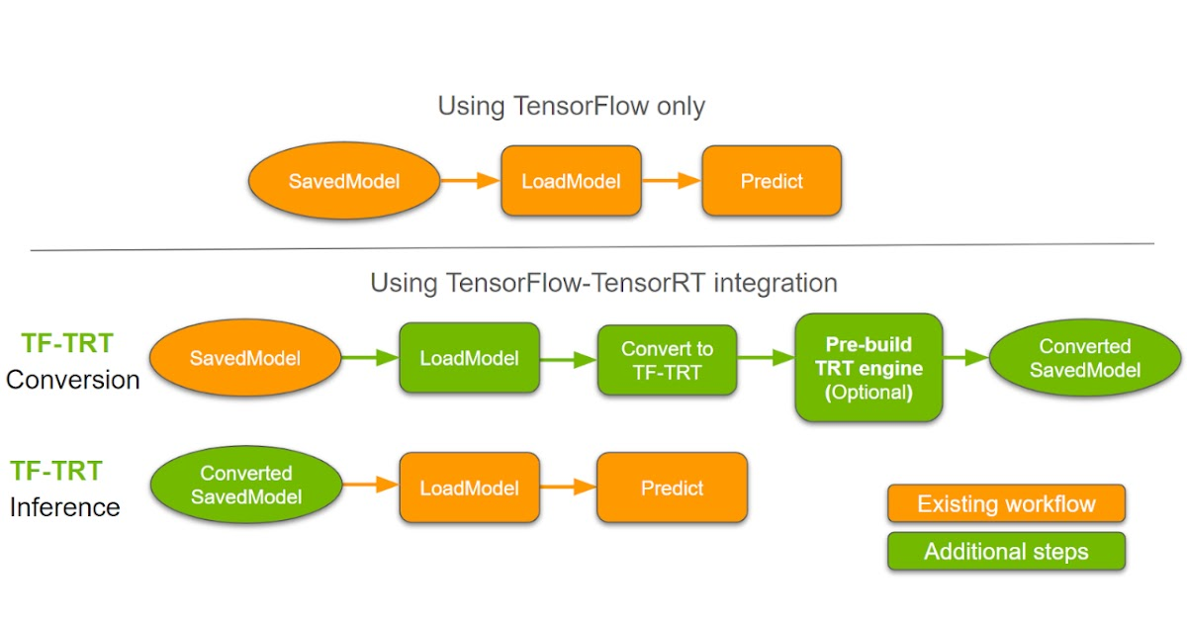
Model deployment

Slide 17


Model deployment
.h5 format
.onnx format
.engine format
(optimized for inference efficiency)

Slide 18
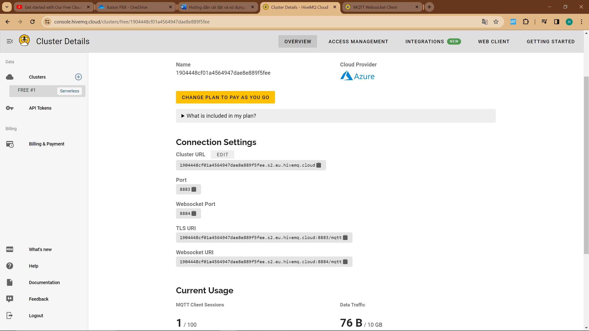
Set up MQTT Broker

Slide 19

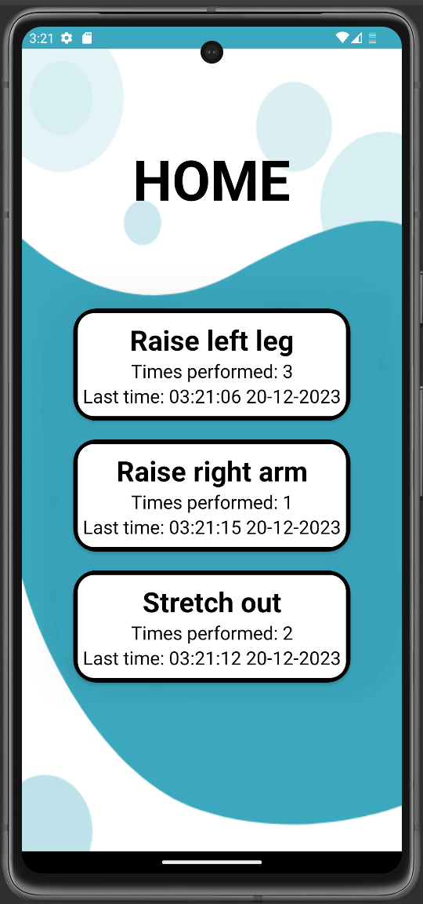

Build client application

Slide 20
DEMO

